Slide 1

Apache Kafka
EDEM Edition 2021

Slide 2
Apache Kafka
Architecture
Producers
Consumers
Kafka Streams
KSQL
Schema registry
Kafka Connect

Slide 3
Apache Kafka

Slide 4

https://www.confluent.io/resources/kafka-the-definitive-guide/

Slide 5


Messaging Systems
Point to Point Messaging System
In a point-to-point system, messages are persisted in a queue. One or more consumers can consume the messages in the queue, but a particular message can be consumed by a maximum of one consumer only.
Once a consumer reads a message in the queue, it disappears from that queue.
Sender
Receiver
Publish-Subscribe Messaging System
In the publish-subscribe system, messages are persisted in a topic. Unlike point-to-point system, consumers can subscribe to one or more topic and consume all the messages in that topic. In the Publish-Subscribe system, message producers are called publishers and message consumers are called subscribers.
Receiver
Sender
Receiver
Receiver

Slide 6
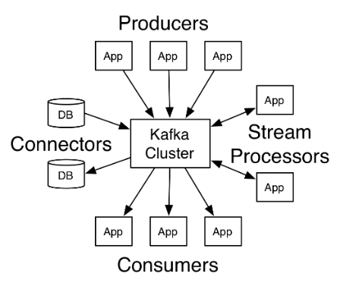


What is Apache Kafka?
Apache Kafka is a distributed streaming platform
Apache Kafka is a realtime, fault tolerant, and highly scalable pub/sub message queue designed as a distributed transaction log.
PRODUCERS
CONNECTORS
Allows an application to publish a stream of records to one or more Kafka topics.
Allows building and running reusable producers or consumers that connect Kafka topics to existing applications or data systems
STREAMS
CONSUMERS
Allows an application to act as a stream processor, consuming an input stream from one or more topics and producing an output stream to one or more output topics, effectively transforming the input streams to output streams
Allows an application to subscribe to one or more topics and process the stream of records produced to them
API
Notes:
Distributed file system for commit log
Features
Fast - Low-latency
Scalable
Durable
Fault-tolerant
Reliable
Replication

Slide 7

Confluent
Confluent is the company behind Apache Kafka founded by Kafka creators
Confluent Open
Confluent Enterprise
Clients (C, C++ or Python)
Connectors (JDBC, HDFS, S3, …)
Schema Registry
REST Proxy
KSQL
Kafka distribution
Docker images / Helm chart
Control Center for monitoring
Multi Data Center Replication
Confluent Cloud – Kafka as a Service
AWS
GCP
Trainings & certification
24/7 Support

Slide 8


Architecture overview
Brokers
Operate as part of a cluster.
Store topic partitions and replicas
Data written to Kafka is written to disk and replicated for fault-tolerance
Receive messages from producers.
Assigns offsets to them
Commits the messages to storage on disk.
Serve consumers
Respond to fetch requests for partitions
Responding with the messages.
Broker
Producer
Consumer
Broker
Producer
Consumer
Kafka uses a zero-copy method to send the messages, from the file directly to the network channel without any intermediate buffers, for a better performance.
Broker
Zookeeper - Keeps track of status of the Kafka cluster nodes
Membership of the cluster
Controller election
Configuration Of Topics
Access control lists
Cluster
Notes:
Kafka messages are persisted on the disk and replicated within the cluster to prevent data loss.
Kafka is built on top of the ZooKeeper synchronization service.
Brokers are simple system responsible for maintaining the published data. Each broker may have zero or more partitions per topic. Assume, if there are N partitions in a topic and N number of brokers, each broker will have one partition.
Assume if there are N partitions in a topic and more than N brokers (n + m), the first N broker will have one partition and the next M broker will not have any partition for that particular topic.
Assume if there are N partitions in a topic and less than N brokers (n-m), each broker will have one or more partition sharing among them. This scenario is not recommended due to unequal load distribution among the broker.
What’s the cluster state? what it is stored in Zookeeper?
Alive brokers
Existing topics and replicas
Leader replicas and follower replicas
In-sync replicas
Consumer-groups
…

Slide 9
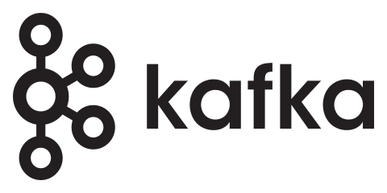
Topics
A stream of messages belonging to a particular category is called a topic
A Kafka Topic is divided into partitions.
Each partition is a totally ordered sequence of messages with unique ID called as offset.
Leader. Every partition has one server acting as a leader.
Partition-0
0
1
2
3
4
5
6
7
8
9
Producer
Producer
Producer
Partition-1
0
1
2
3
4
5
6
7
8
Producer
Partition-2
0
1
2
3
4
5
6
7
8
9
10
If there are N partitions in a topic and N number of brokers, each broker will have one partition.
If there are N partitions in a topic and more than N brokers (n + m), the first N broker will have one partition and the next M broker will not have any partition for that particular topic.
If there are N partitions in a topic and less than N brokers (n-m), each broker will have one or more partition sharing among them.

Slide 10
Replicas
Replicas are spread across available brokers
Backups of a partition
Used to prevent data loss.
Partition 1
Replica
Partition 1
Replica
Partition 1
The controller is one of the Kafka brokers responsible for electing partition leaders.
Partition 2
Partition 2
Replica
Partition 2
Replica
Do not serve client requests; just stay up-to-date with the leader
Consume messages from the leader just as a normal Kafka consumer would do.
ISR (in-sync replicas) when not too far; how far behind is too far is configurable
If the leader replica crashes, one of the ISR will be promoted to leader
Partition 3 Replica
Partition 3
Partition 3 Replica
Partition 4 Replica
Partition 4 Replica
Partition 4
Topic
4 - Partitions
Replication factor 2
Broker
Broker
Broker
Broker

Slide 11
Record Retention
Published records (consumed or not) are retained for a configurable period
Records are available for consumption until discarded by
Time – configurable retention period of time
Size – configurable retention based on partition size
Compaction – keeps latest record for each key
Performance is not affected by large partitions so retention can be extremely large
Unlimited? As soon as your storage is unlimited too

Slide 12
Log Compaction
Compacted topics provide a very different type of stream, maintaining only the most recent message of a given key
Kafka makes extensive use of them internally
e.g: persistence and tracking of consumer offsets
User’s applications: useful for changelog-type data, where only the last update is interesting
e.g: restoring in-memory service after a crash, reloading a cache, …
Log compaction periodically runs in background
Compaction allows for deletes – record with key and null value
All offsets remain valid, even if the record at offset has been compacted
0
1
2
3
4
5
6
K1
K2
K1
K3
K2
K1
K2
V1
V2
V3
V4
V5
V6
V7
3
5
6
K3
K1
K2
V4
V6
V7

Slide 13
Producers
A Kafka producer is an application that can act as a source of data in a Kafka cluster.
A producer can publish messages to one or more Kafka topics
Existing send methods
Fire-and-forget: Don’t wait for ACK - very high throughput - acks=0
Asynchronous: Wait for the Leader ACK - acks=1
Synchronous Wait for Leader + Replicas ACK – Safe - acks=all
Kafka producers attempt to collect sent messages into batches to improve throughput.
Partition assignment
Round-robin
Partition function based on the key
e.g: all records for an employee-id go to the same partition
METADATA
BATCH
Producer

Slide 14
Consumers
Partitions are assigned to the Consumers within the Consumer Group
Consumers remember offsets where they left off. – commit to Kafka.
Moving partition ownership from one consumer to another is called a rebalance. Short window of unavailability of the entire consumer group
Partition-0
0
1
2
3
4
5
6
7
8
9
Consumer
Offset: P0-7
Topic
Partition-1
0
1
2
3
4
5
6
7
8
Consumer
Offset: P1-5
Partition-2
0
1
2
3
4
5
6
7
8
9
10
Consumer
Offset: P2-6
Consumer Group

Slide 15
Delivery Semantics
At most once.
A message should be delivered maximum only once. It's acceptable to lose a message rather than delivering a message twice in this semantic.
At least once
It is acceptable to deliver a message more than once but no message should be lost. The producer ensures that all messages are delivered for sure, even though it may result in message duplication.
Exactly once
A message must be delivered only once and no message should be lost. This is the most difficult delivery semantic of all.
Throughput
Latency
Throughput
Latency
Throughput
Latency
Based on broker and producer configuration, all semantics are supported.
Notes:
At least once: if the producer receives an acknowledgement (ack) from the Kafka broker and acks=all, it means that the message has been written exactly once to the Kafka topic. However, if a producer ack times out or receives an error, it might retry sending the message assuming that the message was not written to the Kafka topic. If the broker had failed right before it sent the ack but after the message was successfully written to the Kafka topic, this retry leads to the message being written twice and hence delivered more than once to the end consumer. And everybody loves a cheerful giver, but this approach can lead to duplicated work and incorrect results.
At most once semantics: if the producer does not retry when an ack times out or returns an error, then the message might end up not being written to the Kafka topic, and hence not delivered to the consumer. In most cases it will be, but in order to avoid the possibility of duplication, we accept that sometimes messages will not get through.
Exactly once semantics: even if a producer retries sending a message, it leads to the message being delivered exactly once to the end consumer. Exactly-once semantics is the most desirable guarantee, but also a poorly understood one. This is because it requires a cooperation between the messaging system itself and the application producing and consuming the messages. For instance, if after consuming a message successfully you rewind your Kafka consumer to a previous offset, you will receive all the messages from that offset to the latest one, all over again. This shows why the messaging system and the client application must cooperate to make exactly-once semantics happen.

Slide 16
Kafka Streams

Slide 17
Kafka Streams
Stream
A stream is the most important abstraction provided by Kafka Streams: it represents an unbounded, continuously updating data set
A stream partition is an, ordered, replayable, and fault-tolerant sequence of immutable data records, where a data record is defined as a key-value pair.
Stream processing application
Any program that makes use of the Kafka Streams library. It may define its computational logic through one or more processor topologies.

Slide 18
Kafka Streams
A stream partition is an, ordered, replayable, and fault-tolerant sequence of immutable data records, where a data record is defined as a key-value pair.
Event-time processing with windowing, joins, aggregations,…
Supports exactly-once processing semantics
Stateful and stateless processing
Kafka Streams DSL
A high-level API that provides the most common data transformation operations such as map, filter, join, and aggregations out of the box
Processor API
A low-level API that lets you add and connect processors as well as interact directly with state stores
Topic - B
Topic - A
Topic - C
Joins, Windowing, Aggregations, …
Materialize
Publish results
Topic - Results

Slide 19
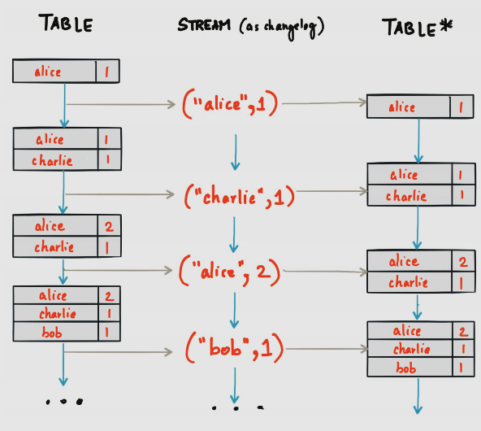
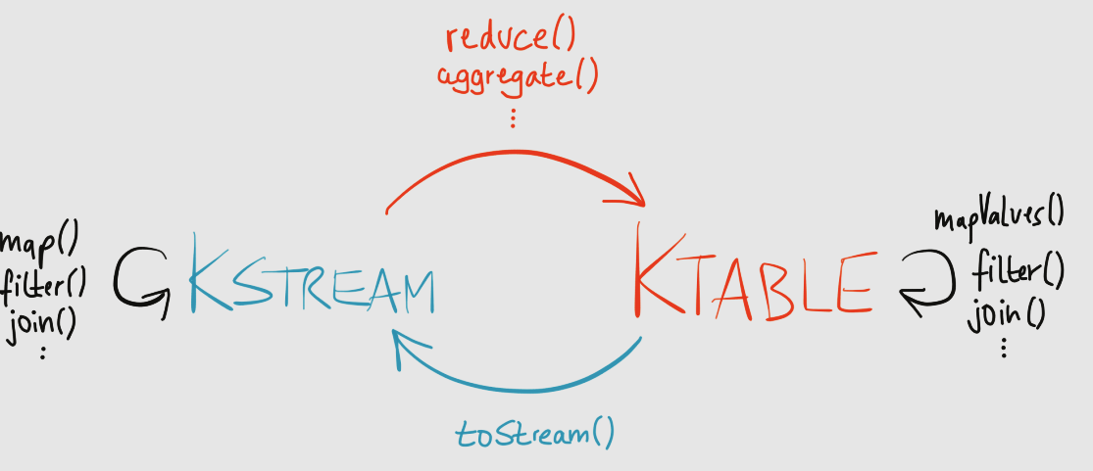
Streams Duality
Stream as Tables
Tables as Streams

Slide 20
State management
Single-Event Processing – does not require state
Which means the processing of a message is independent from the processing of all other messages
Processing with Local State
Most stream-processing applications are concerned with aggregating information, especially time-window aggregation → KTable
Internally Kafka Streams provides a fault-tolerant state store using both:
an internally created and compacted changelog topic
an embedded RocksDB instance
Multiphase Processing
Two-phase approach
Write intermediate results to a new topic with a single partition
Read the intermediate topic with a single consumer instance

Slide 21
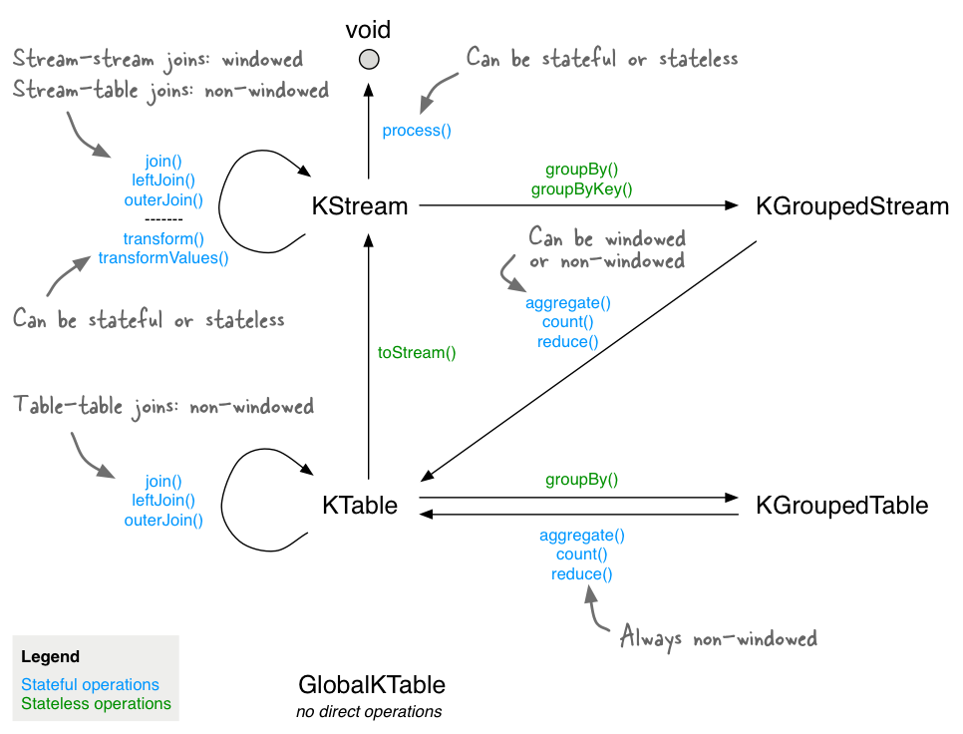
Kafka Streams Operations
Stateless transformations do not require state for processing and they do not require a state store associated with the stream processor.
Stateful transformations depend on state for processing inputs and producing outputs and require a state store associated with the stream processor.

Slide 22
KSQL

Slide 23

KSQL
Easy to use
CREATE STREAM, CREATE TABLE,
SELECT, JOIN, GROUP BY, SUM, …
KSQL
KStreams, KTable, filter(), map(),
flatMap(), join(), aggregate(),…
Kafka Streams
Abstraction
subscribe(), poll(), send(), flush(), beginTransaction(),…
Producer / Consumer
Flexibility

Slide 24



KSQL
KSQL is built on Kafka Streams
KSQL engine – processes KSQL statements and queries
REST interface – enables client access to the engine
KSQL CLI – console that provides a command-line interface (CLI) to the engine
KSQL UI – enables developing KSQL applications in Confluent Control Center
Query Your Streams Without Writing Code
KSQL
Server
KSQL
Server
KSQL
Server
JVM
JVM
JVM

Slide 25
Schema registry

Slide 26
Kafka Schema Registry
Why?
Avro requires the entire schema to be present when reading the record so the schema needs to be located somewhere
How?
Store all the schemas used to write data to Kafka in the registry
Storing the schema and pulling it up when required is automatically done when using KafkaAvro(De)Serializer
Benefits
Tackling organizational challenges of data management
Resilient data pipelines
Safe schema evolution
Storage and computation efficiency
Data discovery
Cost-efficient ecosystem
Data policy enforcement
Source: https://www.confluent.io/blog/schema-registry-kafka-stream-processing-yes-virginia-you-really-need-one/

Slide 27
Kafka Schema Registry
By Confluent
Schema Registry provides a serving layer for your metadata (schema)
RESTful interface for storing and retrieving Avro schemas
Named and versioned schemas – history of all schemas
Kafka records can have a Key and a Value and both can have a schema.
Serializers that plug into Kafka clients that handle schema storage and retrieval for messages that are sent in Avro format
Command-line formatters for automatically converting JSON messages to AVRO and vice-versa
Design
Uses Kafka as its underlying storage mechanism and Zookeeper for synchronization tasks
Single master architecture – only master writes on underlying Kafka log, all nodes are capable of serving reads

Slide 28
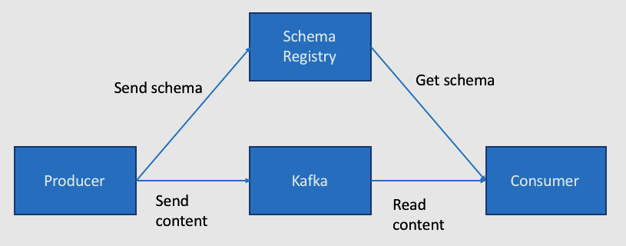
Kafka Schema Registry Example
Just use Confluent’s KafkaAvroSerializer and KafkaAvroDecoder
Producer checks if the schema is in Schema Registry; if not, it will register and cache it
Schema Registry verifies if the schema is either the same as before or a valid evolution; if not, it will return an exception
Producer just includes the Schema ID in the message sent to Kafka; messages become much smaller!
Consumer gets the schema from Schema Registry and de-serializes content
Kafka is used as the Schema Registry storage backend

Slide 29
Kafka Connect

Slide 30


Kafka Connect
SOURCE
SINK
A Source Connector
ingests data from different sources to Kafka topics.
A Sink connector delivers data from Kafka topics into 3th party systems.
Data Centric Pipeline: use meaningful data abstractions to pull or push data to Kafka.
Flexibility and Scalability: run with streaming and batch-oriented systems on a single node or scaled to an organization-wide service.
Reusability and Extensibility: leverage existing connectors or extend them to tailor to your needs and lower time to production.
Kafka Connect runs as a cluster of worker processes

Slide 31
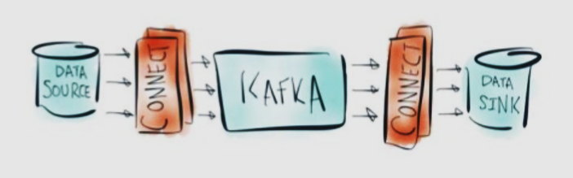
Kafka Connect
Provides
Framework to easily integrate Kafka with other systems
Reusable components library
Source Connectors
Sink Connectors
Features
Scale out
Fault Tolerance
Central Management
REST API
Schema Propagation
Kafka Connect runs as a cluster of worker processes
Install Apache Kafka on all the machines and simply start the brokers on some servers and start connect on others

Slide 32
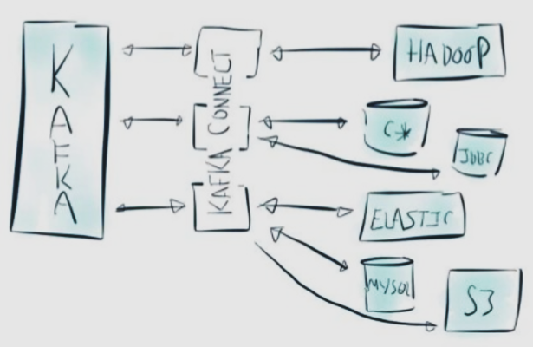
Kafka Connect
Kafka all the things!
Hadoop
Cassandra
JDBC
Elastic
S3
Azure IoT Hub
Couchbase
Oracle Golden Gate
SAP HANA
Vertica
Apache Ignite
GitHub
Google PubSub
Google BigQuery
Hazelcast
HBase
JMS
Kudu
MarkLogic
MongoDB
RabbitMQ
Redis
RethinkDB
Salesforce
Solr
Splunk
Twitter
Kinetica
…
Source: https://www.confluent.io/product/connectors/

Slide 33
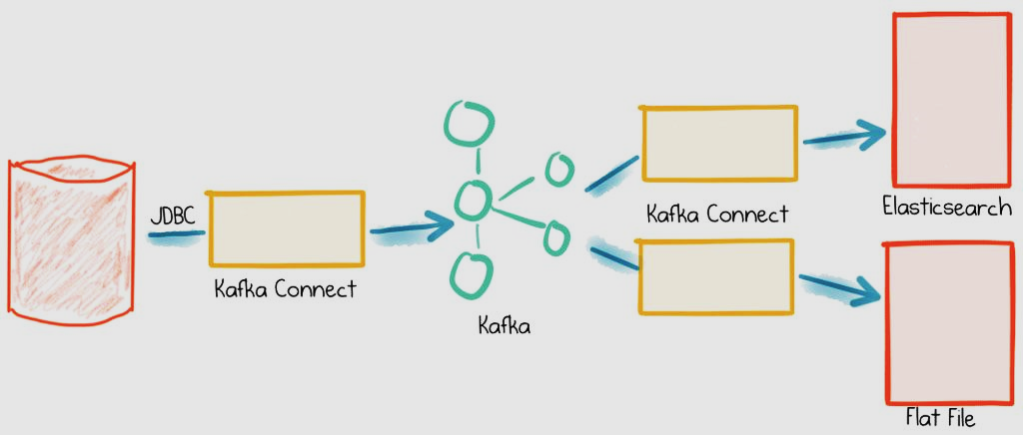
Kafka Connect Example
$ ./bin/confluent start
$ ./bin/confluent load jdbc_source_mysql_foobar_01 -d /tmp/kafka-connect-jdbc-source.json
$ ./bin/confluent load file-sink-mysql-foobar -d /tmp/kafka-connect-file-sink.json
$ ./bin/confluent load es-sink-mysql-foobar-01 -d /tmp/kafka-connect-elasticsearch-sink.json
Source: https://www.confluent.io/blog/simplest-useful-kafka-connect-data-pipeline-world-thereabouts-part-1/
https://www.confluent.io/blog/blogthe-simplest-useful-kafka-connect-data-pipeline-in-the-world-or-thereabouts-part-2/
https://www.confluent.io/blog/simplest-useful-kafka-connect-data-pipeline-world-thereabouts-part-3/

Slide 34
EDEM Edition 2021
GFT
Rubén Sanchis
Solution & Data Architect ruben.sanchis@gft.com
Notes:
GFT Brasil Consultoria Informática Ltda.
GFT Canada Inc.
GFT Costa Rica S.A.
GFT Experts GmbH
GFT Financial Limited
GFT France S.A.S.
GFT Holding Italy S.r.l.
GFT IT Consulting S.L.U.
GFT Italia S.r.l.
GFT México S.A. de C.V.
GFT Poland Sp. z o.o.
GFT Real Estate GmbH
GFT Schweiz AG
GFT Smart Technology Solutions GmbH
GFT Technologies Belgique S.A.
GFT Technologies Canada Inc.
GFT Technologies S.A.U.
GFT Technologies SE
GFT Technologies Toronto Inc.
GFT UK Limited
GFT USA Inc.
GFT Appverse, S.L.U.

